Slide 1
Safety Planning: A Critical Mental Health Intervention to Mitigate Suicide Risk
Monica vonAhlefeld, LISW
Lead Bridge Clinician
Psychiatric Intake Response Center (PIRC)Dep
Worker/ Bridge Clinician
Psychiatric Intake Response Center (PIRC)
Jesse McFerran, LISW
Emergency Department Social Worker
Psychiatry Intake Response Center (PIRC)

Slide 2
Presentation Objectives
Understand the necessary elements to create an effective mental health safety plan.
1
Understand that Safety planning is a critical intervention with individuals at risk for suicide.
2
Understand that a Safety Plan and a suicide risk assessment, such as the C-SSRS, work cooperatively to decrease risk.
3

Slide 3
PIRC
Psychiatric
Intake
Response
Center
513-636-4124

Slide 4
PIRC Levels of Care
PIRC completes the Psychiatric Emergency Assessment (C-SSRS) in the Emergency Department.
Possible referrals:
Inpatient Psychiatric Hospitalization
Partial Hospitalization Program (PHP)
Bridge Clinic
Intensive Outpatient Program (IOP)
Internal Departments
*Safety Planning occurs during all levels of care

Slide 5
PIRC Bridge Clinic
Notes:
We are trying to Bridge the gap to mental health services for youth.

Slide 6
PIRC Bridge Clinic
PIRC Bridge Clinic - An alternative clinic established in 2017 to provide psychiatric assessments, brief crisis support, mental health resources/referrals and assistance with coordination of ongoing mental health treatment.
Emergency Department Diversions - PIRC Intake will review criteria and refer to Bridge for a Psychiatric Intake Assessment. The outcome may be admission to Psychiatry, Safety Planning, Brief Crisis support, and/or referrals to other levels of care (PHP, IOP, etc.).
Brief Crisis Services - Patients without a mental health provider may meet criteria for brief crisis services in Bridge Clinic.
* Safety planning is a critical function of the Bridge Clinic.

Slide 7
Barriers to Safety
During a Mental Health Crisis
Mental Health Stigma
Fear of the Hospital
Fear of Parent Awareness (punitive measures, emotional attachment, anxiety)
Communication Concerns
Feeling out of control
Perceived inability for others to help
Mistrust of the Intentions of others
Lack of Experience with Mental Health Support

Slide 8
Safety Planning Breaks Down Barriers

Slide 9
What is a Safety Plan?
A Safety Plan is a plan that draws on the strengths of the individual and provides safe, healthy, and supportive options when in crisis for the purpose of avoiding unsafe behaviors.
According to the Centre for suicide prevention,
“A safety plan is an assets-based approach designed to focus on a person’s strengths. Their unique abilities are identified and emphasized so they can draw on them when their suicidal thoughts become intense.”

Slide 10
Safety Plan Objectives
Goal = Safety Future Risk
Propose safe options for future crises.
Reinforce feelings of control.
Assist with treatment goals.
Provide reassurance for the individual and guardian/family.
Enhance Communication to decrease risk.
Highlight strengths and provide encouragement.

Slide 11
First Determine Risk
A Safety Plan is formulated AFTER risk is assessed and WHEN it is determined appropriate and safe to proceed. When assessing risk, the provider must ask specific questions about suicidality.

Slide 12
Safety Plan Basics
Youth is stabilized – Not expressing imminent risk and can discuss (or show with behavior) that no safety concern exists. Youth exhibits self- awareness and engagement in the process.
Youth, provider and guardian are present – Guardian is key in establishing safety when youth leaves your presence. Interventions draw upon youth/guardian collaboration and communication.

Slide 13
Guardian Involvement - Imperative for Youth Safety Planning
Youth ~ Guardian ~ Support Provider
Guardian involvement and agreement with this plan of care is imperative.
Youth MUST be engaged and willing to participate with the exception of youth not developmentally able to participate.
Support Provider who can assist in a risk assessment and if appropriate, the safety plan.

Slide 14
C-SSRS and Protective Factors Guide Safety Planning
C-SSRS and Protective Factors help to identify potential risk.
C-SSRS assesses Suicidal ideation, Suicidal Intensity, Suicidal Behavior.
Intent (Stated or Implied) is of Primary Importance when considering whether or not to Safety Plan.
Protective factors promote well-being and when present, can decrease risk.

Slide 15
Benefits of Safety Planning
Outside of the ED
Immediate Safety Concern Emergency Department
Safety Planning
Least Restrictive
Least Traumatic
Does not stress families - Logistics/Financial Stressors
Avoids transmission risk/ ED exposure

Slide 16
Some Examples of Appropriate Referrals to PIRC or the Emergency Department
Guardian has an acute safety concern that cannot be managed safely at home.
Recent or immediate suicide attempt.
Youth expresses intent to act on acute harm to self or others.
Youth is unwilling to discuss suicidality or engage in safety planning.
Medical concerns (possible ingestion, deep cuts, etc.)
Provider or guardian instincts show concern that the youth is at imminent risk.
Additional social or environmental dynamics increase risk factors already present.

Slide 17
Trust Your Instincts
Every situation is unique. Sometimes Safety Planning is an appropriate deterrent from the ED.
Trust your instincts about safety and call PIRC
(513-636-4124)
for guidance when considering the Emergency Department.

Slide 18
Protective Factors

Slide 19
Protective Factors
Social Connectedness
Connectedness to parents/ non-parental adults/ friends/ neighbors
Connectedness to community organizations (schools, faith groups).
Self-esteem/Sense of Purpose
Life Skills
Problem solving/ Coping skills
Adaptability to change
Overall resilience – positive self-concept and optimism
Academic Achievement
Cultural, religious, personal beliefs that discourage suicide.
Access to Effective Behavioral Health Care
(Suicide Prevention Resource Center,
https://www.sprc.org/about-suicide/risk-protective-factors)

Slide 20
Case Examples
Protective Factors
Jordan, age 11, has experienced suicidal thoughts and increased anxiety since COVID quarantine began. He states, “No matter how bad I feel, I would never act on suicide because of my grandmother.” (Social connectedness)
Serenity, age 14, has history of one intentional ingestion. She reports that the act is now a deterrent from ever attempting to end her life again. She was afraid, regretted the act instantly, and states that she learned from it. Serenity is proud that she now uses coping skills and tells her mom when she has suicidal thoughts. (Life skills, Self esteem, Sense of Purpose)
Morgan, age 15, has a history of anxiety and depression and she feels the highest anxiety at school. She is engaged in therapy, trusts her therapist, and seeks her out at school when struggling with her emotions and stressors. (Access to Effective Behavioral Health Care)

Slide 21
Safety Plan or Refer to the Emergency Department?
The next activity determines whether Safety Planning is appropriate or a referral to the Emergency Department.
The C-SSRS and Protective Factors should help you make your determination.

Slide 22
Group Discussion #1 Sydney
Sydney, age 15, is sent to the office after her friends notify school staff that she posted suicidal thoughts on Social Media last night. Sydney’s messages stated that she was going to end it all after school today. Sydney is initially resistant to talk to the School Counselor, but eventually talks. The C-SSRS is completed. Sidney states that she currently wants to die and does not have a method, but wishes she had the ability to do “something” to end her life now. Sydney denies history of suicide attempts. Her suicidal thoughts are persistent and occur many times each day. She frequently wants to find something to complete the act.
Sydney does not have a Therapist and says she doesn’t want to talk to one. In the past, her Therapist shared everything with her mother, so she doesn’t trust Therapists.
Sydney is angry at her friends and is not going to talk to them for telling staff. Sydney reports that she will be in trouble with her mom for posting her thoughts. She states that now she will be locked up in a “mental hospital” and she should have just ended it all last night.

Slide 23
Group Discussion : 10 minutes
1. Discuss Sydney’s protective factors and risk factors.
2. Would you refer to the ED or complete a Safety Plan?

Slide 24
Protective Factors / Risk Factors
Protective Factors:
Sydney shared her feelings with others via Social Media and eventually talks to the Counselor.
Risk Factors:
Sydney is expressing intent to act on her thoughts.
Sydney does not believe others can help her.
Sydney believes that she will be punished for sharing her thoughts.
Sydney believes that sharing has made things worse for her (friends, mother, next steps).
Sydney describes suicide as a “solution” to her current stressors.
Sydney plans to isolate further
from others.

Slide 25
Recommendation for Sydney
Express your concern.
Staff should remain with Sydney at all times.
Notify Sydney of all steps.
Contact Sydney’s mother.
Notify mother of all concerns and statements.
Engage Sydney and her mother in discussion of next steps and why.
Call PIRC to refer to the Emergency Department and to provide collateral information.

Slide 26
Group Discussion #2 John
John, age 14, asks to speak with his School Therapist today. He tells her that sometimes when experiencing a panic attack, he thinks that he should end his life. He states that he hates his anxiety and the associated thoughts.
The Therapist completes the CSSRS and John denies current suicidal thoughts or intent. John reports that he experiences suicidal thoughts 2-3 times per week. Suicidal thoughts last occurred a week ago. At that time, he did not have intent to act on his thoughts. The last time John experienced intent to act was two years ago. At that time, he ingested 12 Ibuprofen pills as an attempt to end his life.
John states that he is very afraid of the Emergency Department, so he has never told anyone about his suicidal thoughts or ingestion. He is sharing today because he now feels comfortable talking about it with his therapist and his anxiety is worsening. John has not notified his mother about the past attempt, but he does tell her about his anxiety. He reports that his mother stays with him and helps him feel better.

Slide 27
Group Discussion : 10 minutes
1. Discuss John’s protective factors and risk factors.
2. Would you refer to the ED or complete a Safety Plan?

Slide 28
Protective Factors / Risk Factors
Protective Factors:
John is now communicating his risk.
John took the chance to share today.
John trusts mother and now Therapist.
John is engaged in therapy.
John wants to feel better and to get help.
John verbalizes what helps him.
Risk Factors:
Distress from anxiety and the associated suicidal ideation.
Previously unreported attempt.
John is afraid of the next steps after sharing.

Slide 29
Initial Information is Encouraging for Safety Planning
John denies immediate intent or plan
Guardian collateral is needed.
If appropriate, proceed with Safety Plan.
John has “Protective Factors”
Contact PIRC to discuss additional mental health supports if needed.
Mother should be made aware of ALL statements made by John and she should be involved in Safety Planning.
*We will revisit this case to highlight Safety Planning / Interventions

Slide 30
Key Components of a Safety Plan
Safety Plans may be individualized for your setting, however some key components are:
Warning Signs/Triggers
Coping skills & Problem Solving
Home Safety Planning
Family/Friends/Community Supports
Steps to Use in Crisis
Crisis Resources

Slide 31
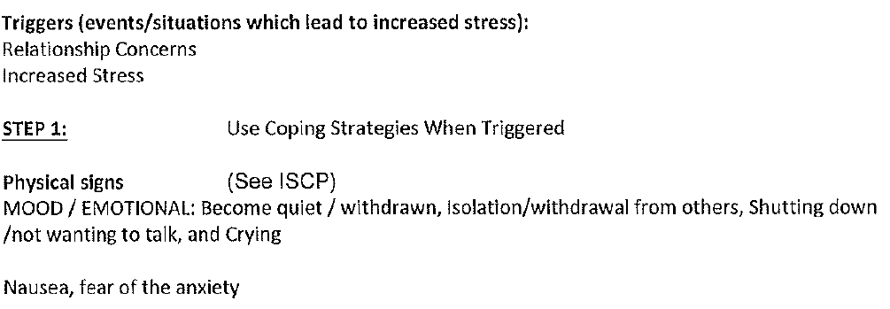
Sample CCHMC Safety Plan Triggers / Warning Signs

Slide 32
Coping Skills/Problem Solving

Slide 33
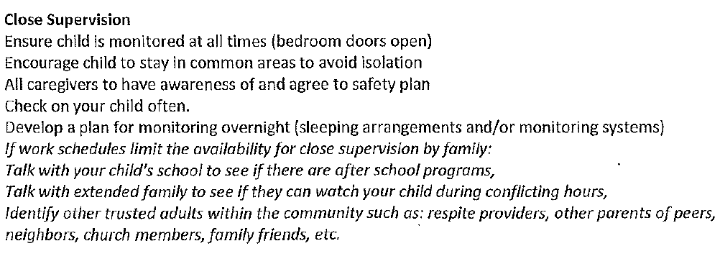
Home Safety Planning

Slide 34
Family/Friends/Community Support

Slide 35
Steps to Use in Crisis

Slide 36
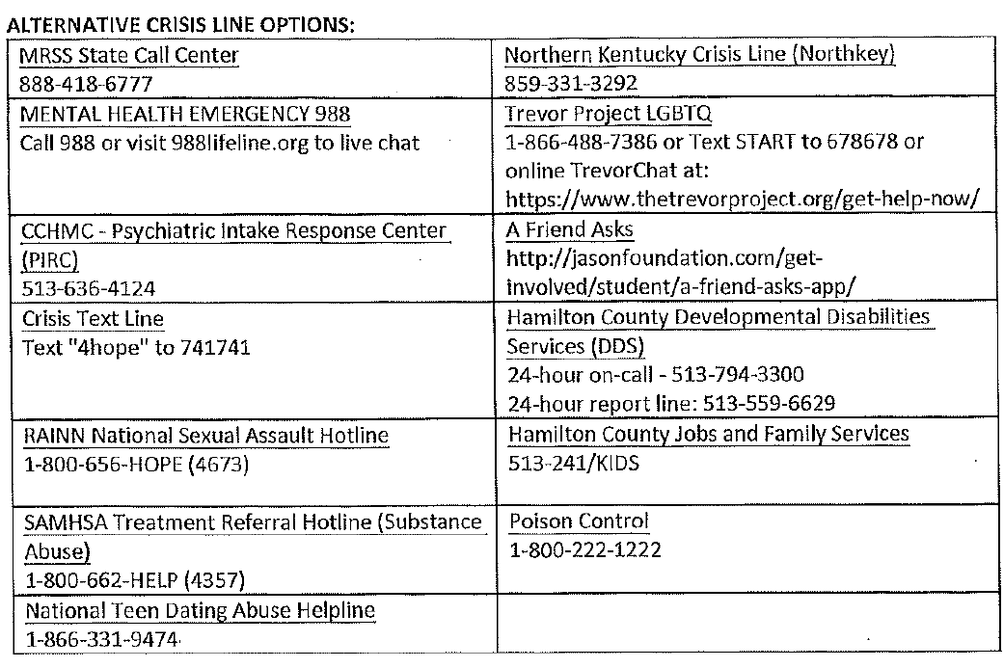
Crisis Resources

Slide 37
Safety Planning Steps
Step One
Risk and Rapport
Step Two
Introduce the Safety Plan / Family Engagement
Step Three
Establish Home Safety
Step Four
Discuss Triggers, Coping Skills and Problem Solving
Step Five
Identify Community Supports and Secure Appointments
Step Six
Encourage Use of Resources and Follow-up
Step Seven
Review Steps to Use in a Crisis

Slide 38
Step One: Risk and Rapport Risk (C-SSRs) Notify guardian of ALL statements made by youth. Give youth the option to share. Tell why you are sharing. Rapport Normalize mental health / discussing feelings/ asking for help. Be creative with ways to encourage feelings of control and involvement in the process. *Building Rapport encourages Communication Praise youth for sharing (Using strengths-based approach). Point out courage/ strength. If possible, do this with guardian present.

Slide 39
Step Two: Introduce Intervention- Family Engagement
Explain the purpose of the Safety Plan.
Encourage guardian’s support and empathy for the child.
Discuss that communication, positive support, and empathy may lead to increased safety.
Encourage youth participation and buy-in (how this will help you and your family) Remember the safety plan is a partnership. Discuss this with youth.
Ask guardian about other safety concerns.

Slide 40
Step Three: Home Safety
Establish Home Safety:
Provide specific information on home safety planning.
(Handouts are recommended). Suicide Safety Precautions at Home (AACAP), Safety Plan Knowing Note CCHMC.
Stress securing ALL items, especially those related to history of plans or methods.
Ask guardian about safety concerns in home. This should be done in private.
Recommend strict rules of safety until further mental health resources are implemented.
*Encourage Safety in all environments and situations.

Slide 42
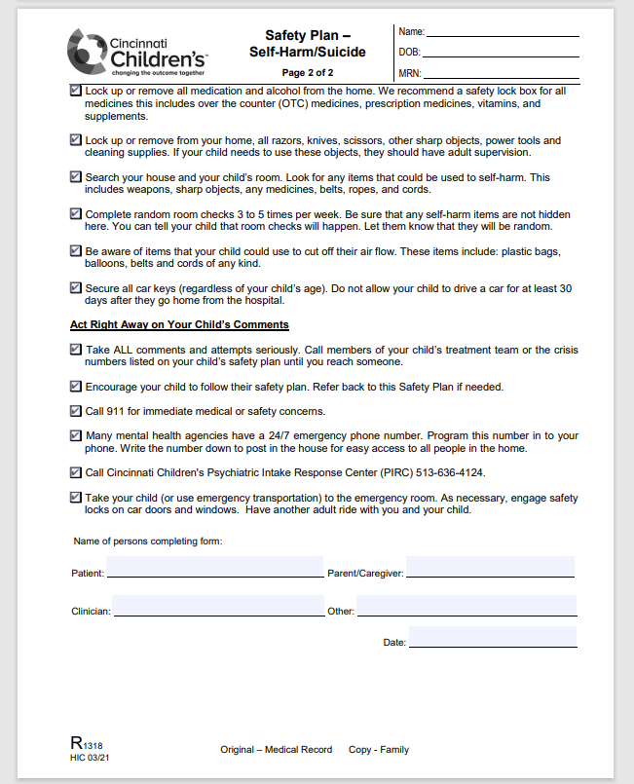

Slide 43
Step Four: Triggers, Coping Skills and Problem Solving
Coping Skills Tool Box/ Problem Solving at Home:
Identify triggers that serve as an alert to use the safety plan (Control).
Youth lists current coping skills used.
Encourage coping skills that may be away from home (school, youth group, etc.)
Encourage youth to ask guardian for help.
Use tools of communication when needed (1-10 rating scale; code word) Communication Journal.
Ask youth what guardian can do if they notice warning signs.

Slide 44
Step Five: Community Supports Secure Appointments
Identify Community Supports/ Secure Appointments:
Tangible plan of action for after-care.
Youth and guardian will provide names/ phone numbers of who to contact when in crisis.
Ensure that child has an adult contact and that they utilize an adult’s support in crisis.
Assist in securing appointments as able. (Primary Care Physician, outpatient therapy, etc.).
If needed, contact PIRC for assistance.

Slide 45
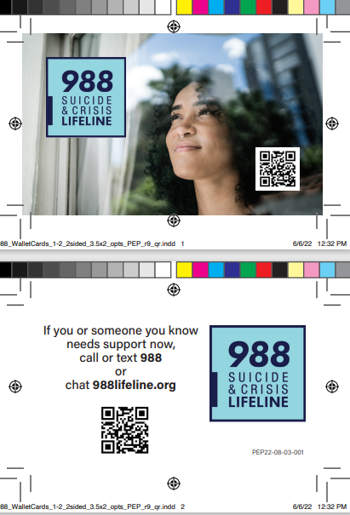
Step Six: Encourage Use of Resources
Encourage Self-Sufficiency and Help Seeking Strategies.
List area resources on crisis plan.
Discuss apps, crisis hotlines and other links to help when in need. Provide wallet cards, etc.
Normalize needing/receiving help.
(Therapists talk to Therapist. Doctors go to Doctors.)
Decrease apprehension/ fear in community support or the hospital.
Non-punitive. OPEN the door to Safety for future risk.

Slide 46
Community Resources
Mobile Response & Stabilization Services (MRSS)
https://mobileresponse.org/
Serving Butler, Preble, Warren and Clinton
Access by calling the County’s hotline 24/7
Butler Co. Mobile Crisis 1 (844) 427-4747
Warren/Clinton Co. Mobile Crisis 1 (877) 695-6333
Preble County: (866) 532-3097
Hamilton Co. Mobile Crisis (513) 584-5098
Clermont Co. Mobile Crisis (513) 528-7283
National Suicide & Crisis Lifeline 988

Slide 47
Step Seven: Review Steps to Use in a Crisis
Summarize the Plan of Action when in Crisis.
Youth will tell guardian/ a trusted adult when feeling unsafe.
Guardian will ask additional questions about feelings, thoughts, safety.
Review the youth’s Crisis Plan (Coping Skills & Problem Solving).
If still in need of help, call mental health provider.
If needing additional assistance of information, call PIRC.
If you have tried the initial steps and guardian feels that youth is unsafe, call 911 or take youth to the nearest Emergency Department.

Slide 48
Practice the Intervention
John: Safety Planning Intervention
Reference your Activity #2 : John
Think about protective factors and risk factors previously considered.
Remember: Safety Planning is an Intervention.
How can you help John to trust?
How can you highlight his strengths?
How can you encourage greater likelihood that John will share future risk if it were to occur?
Use the Safety Plan Steps to Practice. Write down some helpful statements/ interventions to be used with John and his mother. (15 Minute Activity)

Slide 49
Safety Planning Steps
Step One
Risk - Rapport- Communication
Step Two
Introduce the Safety Plan / Family Engagement
Step Three
Establish Home Safety
Step Four
Discuss Triggers, Coping Skills and Problem Solving
Step Five
Identify Community Supports and Secure Appointments
Step Six
Encourage Use of Resources and Follow-up
Step Seven
Review Steps to Use in a Crisis

Slide 50
Practicing the Intervention
Step One – Risk and Rapport
Risk
Review C-SSRS with John’s mom.
Involve John’s mother – identify unknown risks.
Establish Rapport
Praise John for talking today about safety.
Normalize mental health / asking for help
Point out strengths.
Communication
Acknowledge that sharing suicidal thoughts with parent can be scary at first.
Discuss parent need to know – to provide safety and support.
Highlight John’s statement that mother helps ; communication about risk can also help.
Allow John to share detail about his thoughts and suicide attempt with his mother.

Slide 51
Practicing the Intervention
Step Two - Introduce the Safety Plan
Establish buy-in.
John sought help and advocated for himself. This plan will also advocate for his health and safety.
Step Three – Home Safety
Provide specific recommendations in writing.
Stress putting away all items that could pose risk (especially medication given history).
Step Four - Discuss Triggers, Coping Skills and Problem Solving
Triggers – anxiety/ worry about parent knowledge about mental health concerns.
Coping Skills – Relaxation strategies, distraction techniques
Communication Journal, 1-10 Scale

Slide 52
Practicing the Intervention
Step Five – Identify Community Supports and Secure Appointments
Next Therapy appointment
List school staff to check-in with
Parent/family/friend supports
Describe the hospital – not punitive, helping, supportive; ED will assess and provide options.
Step Six - Encourage use of resources and follow- up
988 Wallet Card
Apps, hotlines
Step Seven – Review Steps to Use in Crisis
Telling a trusted adult – WOULD John now share with his mother?
Mother will ask additional questions
Call Mental Health Therapist
Review safety plan
Call PIRC
Emergency Department/ 911 if needed

Slide 53
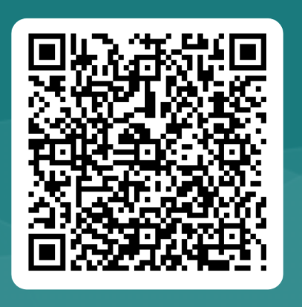
Sign and Evaluation Reminder
Thank you for joining us for the Suicide Screening, Assessment Tools and Safety Planning Training.
Please sign in at https://rb.gy/vkxv3 or scan the QR code.

Slide 54
References
Barrister, Teri, PhD., LPC. (2018). Navigating a Mental Health Crisis. A NAMI resource guide for those experiencing a mental health emergency. Retrieved from
https://www.nami.org/Support-Education/Publications-Reports/Guides/Navigating-a-Mental-Health-Crisis/Navigating-A-Mental-Health-Crisis
Centre for Suicide Prevention. (September 9, 2019). Safety Plans to Prevent Suicide. Retrieved from https://www.suicideinfo.ca/resource/safety-plans/.
Benarous, Milhiet, Oppetit, Viaux, El Kamel, Guinchat, Guile and Cohen. (2019). Frontiers in Psychiatry. Changes in the Use of Emergency Care for the Youth With Mental Health Problems Over Decades: A Repeated Cross Sectional Study. Retrieved from https://www.ncbi.nlm.nih.gov/pmc/articles/PMC6372506/

Slide 55
Questions?

