Slide 1
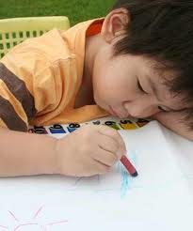
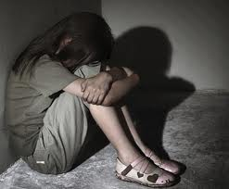
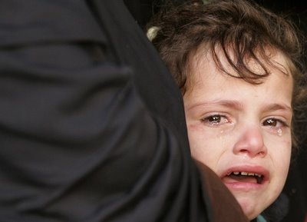
Trauma-Informed Care Training

Slide 2
Learning Objectives
Define Trauma-Informed Care
Understand Child Traumatic Stress
Understand the effects trauma has on child development, behaviors, and functioning
Recognize, prevent, and cope with Compassion Fatigue
Recognize that many parents Child Welfare workers encounter have also experienced trauma when they were children

Slide 3
What is Trauma-Informed Care?
“Trauma Informed Care is a strengths-based framework that is grounded in an understanding of and responsiveness to the impact of trauma…that emphasizes physical, psychological, and emotional safety for both providers and survivors…and, that creates opportunities for survivors to rebuild a sense of control and empowerment.” ~(Hopper, Bassuk, & Olivet, 2010, pg. 82)

Slide 4
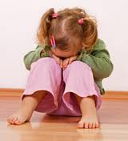
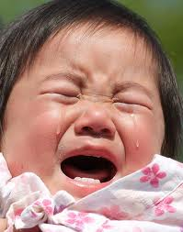
What Makes an Event Traumatic?
Traumatic Events are:
Sudden, unexpected, and extreme
Usually involve physical harm or perceived life threat (research shows the perception of “life threats” are powerful predictors of the impact of trauma)
People experience these events as out of their control
Certain stages of life makes people vulnerable to the effects of trauma including childhood, teens and early twenties. ~(Tedeschi, 2011)

Slide 5
What is Child Traumatic Stress?
Child traumatic stress is the physical and emotional response a child has to events that pose a threat to the child or someone important to them.
When a child experiences trauma, the child may be unable to cope, have feelings of terror and powerlessness and experience physiological arousal they cannot control.

Slide 6
What is Child Traumatic Stress? (Cont’d)
A traumatic event can affect the way children view self, the world around them, and their future.
A child who is traumatized may not be able to trust others, may not feel safe, and may have difficulty handling life changes.

Slide 7
Types of Trauma
Acute trauma is a one-time traumatic event. Some examples of acute trauma are:
An auto accident
A violent event in the community, such as a shooting
A natural disaster such as a flood or a hurricane
A sudden loss of someone the child cares about
An assault
When a child experiences acute trauma, he or she may experience a range of emotions and physical reactions that are quite overwhelming.

Slide 8
Types of Trauma (Cont’d)
Chronic trauma occurs when children experience multiple traumatic events.
These events may be varied in circumstances. For example a child may suffer ongoing sexual abuse, be a victim of physical assault at school, and then be involved in a car accident each contributing to chronic trauma.
Chronic trauma can have a cumulative effect. Subsequent traumatic events remind the child of prior trauma and can trigger emotions and thoughts related to that prior trauma.

Slide 9
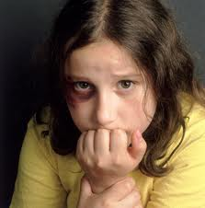
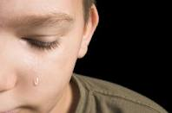
Types of Trauma (Cont’d)
Complex trauma refers to the impact chronic trauma has on a child’s life and developing systems.
A child who has complex trauma has experienced multiple traumatic events, often from early childhood and this can have a profound impact on the child’s development and ability to function normally.

Slide 10
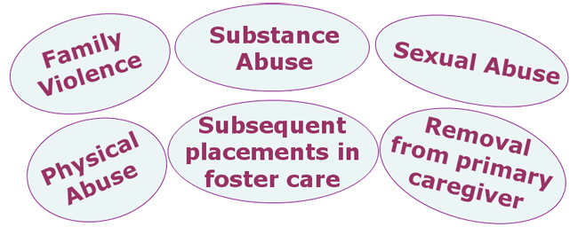
Most children who become involved in the child welfare system have likely had multiple exposures to trauma.
Universal Precautions Approach
The prevalence of trauma is so high that child welfare workers should assume that everyone they serve has a trauma history. (Hodas, 2004)

Slide 11
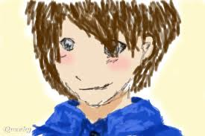
Bryce’s Story
“Hey, I’m Bryce and I’m 9 years old. I just came to live with my grandma because my mom’s boyfriend has been hitting her and then he got really mad one day and hit me in the face and I couldn’t open my eye. I miss my mom and I’m worried about her-she’s all I have, my dad died when I was 5 from drugs.”

Slide 12
Bryce’s Story
Bryce’s grandmother reports that he is having nightmares and is very “jumpy.” He scares easily at loud noises. Bryce is sometimes withdrawn and will not talk and he has had a few anger outbursts.
Bryce has experienced multiple traumatic events (chronic trauma) such as the death of his father, witnessing family violence, physical abuse by his mother’s boyfriend, and separation from his primary caregiver and these events are having an impact on Bryce’s functioning and sense of safety (complex trauma).

Slide 13
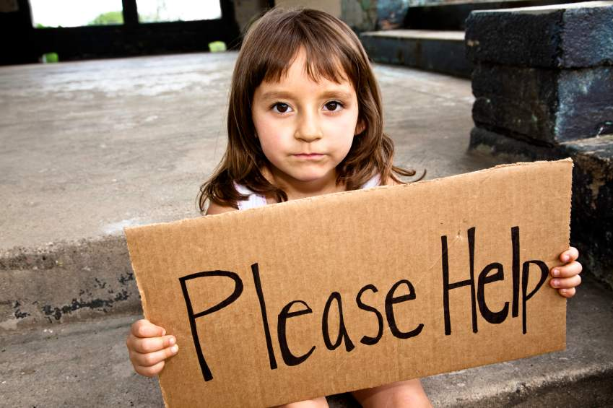
Other Sources of Stress
The children we serve may also face other stresses in their life such as:
Poverty
Discrimination
Separations from caregivers and family members
Frequent placements (or moving around often)
Problems at school
Immigration issues

Slide 14
How a Child Responds to Stress and Trauma
Children respond in different ways to traumatic events. What may be a traumatic event for one child, may not be for another child.
The objective nature of the event and the child’s subjective response determines the effect that event will have on the child.

Slide 15
How A Child Responds to Stress and Trauma (Cont’d)
Several things factor into the effect of a traumatic event for a child and should be considered when assessing that child’s trauma history, for instance:
The age and developmental level of the child
How the child perceived the danger
The role the child played in the event (victim or witness)
Previous trauma the child has experienced
Protective capacities of adults involved in the child’s life

Slide 16
What Does This Mean for Child Welfare Workers?
Building Trauma Informed Care Systems requires a Paradigm Shift from the Question:
“What is wrong with you?” to “What happened to you?”
A child’s behavior may be indicative of:
Coping Mechanisms
Survival Techniques
Resiliency
Ask yourself:
Is what I am doing respectful and trauma-informed?
Am I treating others the way I want to be treated?
One of the most important things we can do as providers is avoid re-traumatizing those we serve.

Slide 17
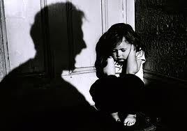
Effects of Trauma on Children
When individuals charged with protecting and nurturing children negate protective responsibilities, the effects are manifested throughout a child’s life.
Children who have suffered trauma are impacted in the following areas:
Attachment
Physical and Psychological development

Slide 18
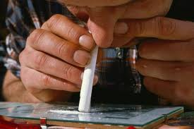
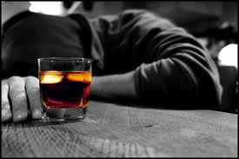
Long-Term Effects of Childhood Trauma
When a traumatized child does not cope with trauma in a healthy manner, the child may be prone to:
Substance abuse
Mental health issues (such as depression and suicide)
Promiscuity
Criminal behavior

Slide 19
Children and PTSD
Children who have experienced multiple traumatic events are often diagnosed with Post Traumatic Stress Disorder (PTSD).
Key symptoms of PTSD include:
The child re-experiences the trauma (typically through flashbacks and nightmares)
The child will avoid stimuli associated with the trauma
The child may disengage from their emotions (may lose interest in things they used to like to do)
The child may have physical symptoms for no medical reason (stomach aches, headaches, etc.)
The child may be more hyper vigilant (startle easily)

Slide 20
Trauma and the Brain
Trauma often has a profound impact on the development of a child’s brain, brain chemistry, and nervous system.
Studies show stress hormones of traumatized children are similar to those of war veterans.

Slide 21
Trauma and the Brain (Cont’d)
Children involved in the child welfare system are often diagnosed with disorders such as:
Reactive Attachment Disorder
Attention Deficit Hyperactivity Disorder
Oppositional Defiant Disorder
Bipolar Disorder
Conduct Disorder
Many children who receive these diagnosis have been victims of multiple traumatic events and it is important that the impact of those traumatic events is considered and evaluated when a child is being assessed for a mental health diagnosis.

Slide 22
Trauma and the Brain (Cont’d)
Let’s take a closer look at how trauma can impact the brain at particular developmental stages.

Slide 23
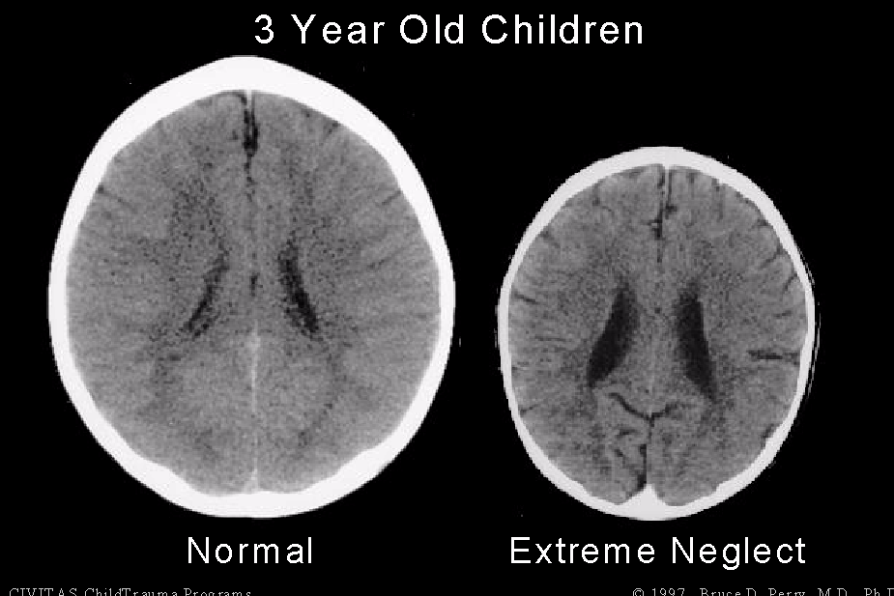
Trauma and the Brain (Cont’d)
In early childhood, trauma can reduce the size of the cortex, which is responsible for complex functions such as language and memory.
To the left is a CT scan of two 3-year-old children. The image on the left is that of a healthy child and represents a normal brain. The image on the right is the image of a severely neglected child. Notice the difference in size. The cortex is significantly smaller which contributes to reduced gross motor abilities and maladaptive development.

Slide 24
Trauma and the Brain (Cont’d)
Trauma in early childhood can also impact the brain’s ability to “cross-talk” between the hemispheres. This includes the parts of the brain that control emotions, which can affect IQ and the ability to regulate emotions.
This can often lead to a child feeling fearful and unsafe.

Slide 25
Trauma and the Brain (Cont’d)
In school-age children, trauma can impact the parts of the brain that are responsible for managing fears, learning, and impulse control. A school-age child who has been traumatized may display the following symptoms:
Problems at school (both behavior and learning)
Disrupted sleeping patterns
May withdraw or become clingy
Difficulty in relationships with siblings and/or peers
Physical symptoms for which there is no medical reason for (aches and pains, feeling sick)

Slide 26
Trauma and the Brain (Cont’d)
In adolescent children, trauma can impact the development of the prefrontal cortex, which is the part of the brain responsible for connecting behaviors and consequences, problem solving, inhibitions, and impulse control.
When this part of the brain has not been fully developed, an adolescent may engage in more risk-taking behavior, make poor decisions, not perform well at school and become involved in criminal activity.

Slide 27
Behavioral and Developmental Effects of Trauma
Take a moment to review the handout, “Behavioral and Developmental Effects of Trauma.”
You can print this handout and use it as a resource in your work with children who have been traumatized.
You will now read the stories of 3 children, Janie, Aaron, and Millie. As you read each of their stories, try to determine if trauma has occurred and what impact that trauma has had on the child.

Slide 28
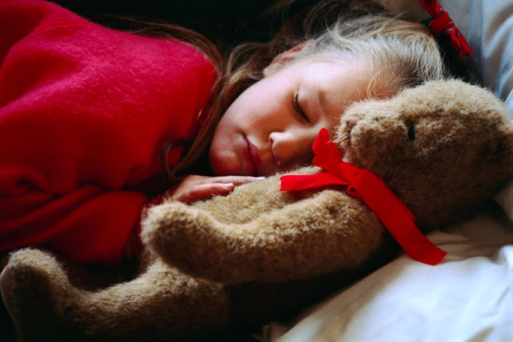
Janie’s Story
Janie is 4 years-old and CPS has become involved in her family’s life due to her mother’s use of methamphetamine. Janie’s mother used methamphetamine about 10 years ago, but had been clean and sober until about 6 months ago. In the past 6 months, Janie has been left in the care of her 7-year-old sister for hours at a time and overnight while her mother is out using drugs. Janie has been exposed to dangerous individuals who have come in and out of the home.

Slide 29
Janie’s Story Con’t
During a party her mom was throwing a few nights ago, a man burned Janie on her arms with his cigarette. Janie and her sister are now living with an aunt. Janie’s aunt reports that Janie was potty-trained at the age of about 2 ½, but has been wetting the bed. Janie also startles very easily and does not want to play with others at her daycare. She keeps to herself and is very withdrawn.

Slide 30
Janie
Janie has been traumatized due to neglectful supervision by her mother, physical abuse by her mother’s friend, and separation from her primary caregiver.
She is displaying effects of trauma through regression to bed-wetting, withdrawal, and her startle reactions.

Slide 31
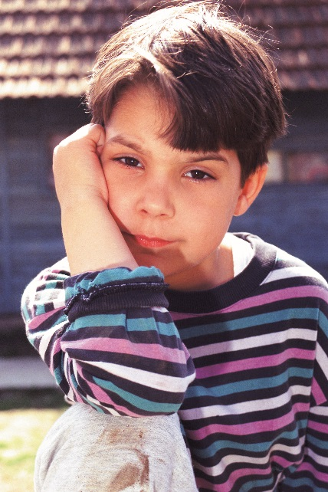
Aaron’s Story
Aaron is 11-years-old and has been in foster care since he was 6. He was removed from the care of his biological parents for severe physical abuse and neglect. He was found to be malnourished, had multiple bruises and both old and new fractures at the time of removal. Parental rights were terminated and Aaron was placed in an adoptive placement, but before it was consummated the adoptive parents decided they could not adopt Aaron and he was placed in a foster home. Since that time he has had 11 subsequent placements in foster homes and one placement in a Residential Treatment Center.
Aaron’s placements report aggressive behavior and unwillingness to follow rules. He has anger outbursts and cannot regulate his emotions. He is currently diagnosed with Bipolar disorder and is on medication. He also has difficulty forming friendships with peers.

Slide 32
Aaron
Aaron has suffered multiple traumas due to abuse and separation by his parents, a failed adoptive placement, and frequent moves.
The effects of these traumatic events are evident in Aaron’s behaviors, emotions, and relationships.

Slide 33
Millie’s Story
Millie is 15-years-old and lives with her mom and younger sister. Millie’s family has become involved with CPS because her mom locks her out of her room. Millie’s mother reports that Millie does not follow rules, she leaves the home at random and stays out until 2 in the morning. She believes she is using drugs and having sex. Millie’s mother reported that she did not know how to keep Millie from leaving the house other than locking her in her room. Millie refuses to go to school on most days and is failing most of her classes.

Slide 34
Millie Con’t
Millie started exhibiting rebellious behavior when she was about 14, after she was sexually assaulted by a boyfriend. Millie’s mother tried to get her to go to counseling, but she refused to go. Millie also was sexually abused when she was 4 years-old by a cousin that she no longer has contact with. Millie’s family has had to move around several times in her life due to her mother’s lack of financial resources. Millie was really close to her grandmother throughout most of her life and she died about 6 months ago.

Slide 35
Millie
Millie has experienced multiple traumatic events due to sexual abuse and loss of a family member.
Millie’s risk-taking behaviors and lack of impulse control is most likely a result of these traumas.

Slide 36
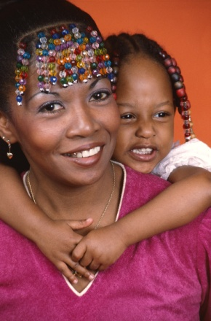
Culture and Trauma
It is always critical in our work with children and families to understand their cultural backgrounds.
This is especially true when assessing a child’s trauma history as culture can influence how the child’s trauma was perceived by the child and his or her family and how the child and family reacted to the trauma. Culture also shapes the healing process in the aftermath of trauma and loss in the form of rituals and healing practices.

Slide 37
Culture and Trauma (Cont’d)
A few things to consider when assessing trauma history and considering the cultural influence include:
How the family and child communicate
How the family responds to the trauma (shame, guilt, blame, denial, acceptance)
Any stress or vulnerability the child and/or family is experiencing because of their culture (discrimination, stereotyping, poverty, less access to resources)
How the child and family feel about interventions regarding the trauma

Slide 38
Historical Trauma
Historical trauma should also be considered. Historical trauma is the cumulative exposure to traumatic events that not only affect the individual exposed, but continue to affect subsequent generations.
Examples:
Legacy of slavery among African Americans
Impact of massacres, removal from homelands, and forced boarding school placements for American Indians and Alaskan Natives
Historical trauma can increase the impact of present-day trauma for a family in the child welfare system especially when actions like removal of children serve as triggers or reminders of the historical trauma for parents and family members.

Slide 39
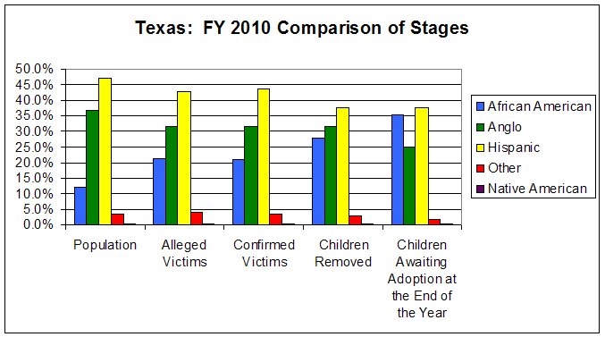
Disproportionality
Disproportionality is the overrepresentation of a particular race or cultural group in a particular program or system. In Texas a higher percentage of African American and American Indian children are removed from their homes. Respectively, a lower percentage are successfully reunified with their families, and a higher percentage age out of foster care without an adoptive family or other permanent placement.

Slide 40
Disproportionality (Cont’d)
Ensuring appropriate services for racial and ethnic minorities requires an understanding of the disparities in:
Knowledge about services
Access to services
Utilization of services &
Quality of services available
The cultural background of child welfare workers and the organization can influence a worker’s perceptions of child traumatic stress and how to intervene.
Therefore, assessment in child welfare should reflect cultural knowledge and competence and always take into account the cultural background of the assessor and child/family.

Slide 41
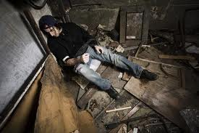
Adults and Trauma
The focus of this training has been on Child Traumatic Stress and how trauma affects a child. It is important to keep in mind that traumatized children may become traumatized adults.
When childhood trauma is not resolved, individuals may continue to live in a state of fear and helplessness. If a child does not receive successful intervention for trauma, they are more susceptible to long-term effects.

Slide 42
Adults and Trauma (Cont’d)
When working with adults involved in the child welfare system, it is important to consider the following:
Any traumatic event that individual has experienced
Can the adult talk about the trauma they experienced?
The response to that event (both from the individual and their family)
Any interventions the individual has engaged in (as a child or as an adult) and their success regarding addressing that traumatic event
Any connections between the adult’s current behaviors and functioning and trauma he or she has experienced

Slide 43
What You Can Do
You play an important role in the lives of children and families. It is important to understand your role in helping traumatized children.
This knowledge will help ensure that children are not misdiagnosed with mental health disorders and that they receive appropriate intervention.

Slide 44
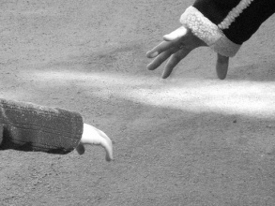
What You Can Do (Cont’d)
Forming trusting attachments and relationships is critical for children who have suffered trauma.
There are several things you can do to help establish a trusting relationship with a child, such as:
Have quality interactions with the child (this means fully engaging with the child and listening to the child)
Do not make commitments or promises that you may not be able to keep
Involve the child in decisions that effect their lives
Focus on the child’s strengths and resilience

Slide 45
What You Can Do (Cont’d)
Additional tips for working with traumatized children:
Set up relationships and situations that avoid re-traumatizing children.
Work with children to discover their "triggers" and ways to stay safe
Focus on children's strengths; what they CAN do and identify their existing coping skills
Ask children for their ideas about how they want to be helped

Slide 46
What You Can Do (Cont’d)
One of the most important tasks you have to accomplish in helping a traumatized child is to manage your own trauma and stress.
Secondary Traumatic Stress or Compassion Fatigue are terms often used to describe the trauma that is experienced by individuals who help others. Let’s explore this topic a little further.

Slide 47
Compassion Fatigue
Compassion fatigue is a natural consequence of helping traumatized individuals. It is often due to the empathy the “helper” feels from working with individuals who have suffered.

Slide 48
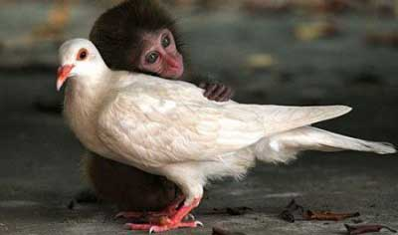
Compassion Fatigue
But empathy is a good thing, right?
Empathy is defined as the capacity to understand another’s state of mind…putting yourself in someone else’s shoes.
Empathy is a positive trait…as long as you care for yourself too.

Slide 49
Symptoms of Compassion Fatigue
Irritability
Apathy
Loss of Motivation
Fatigue
Overwhelmed
Loss of interest in things you enjoy
Intrusive thoughts (especially about work)

Slide 50
Burnout vs. Compassion Fatigue
Individuals in the helping profession may experience “burnout.” It is important to understand that “burnout” and Compassion Fatigue are very different, but can produce very similar symptoms.
People who are truly “burned out” lose the ability to empathize. Individuals who experience Compassion Fatigue, desire to help and empathize with the children and families they serve. However, they become overwhelmed by their own thoughts and feelings to do so.

Slide 51
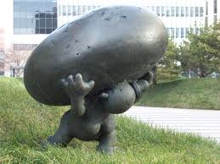
Dealing with Compassion Fatigue
The good news is, there are things you can do to protect yourself from Compassion Fatigue and to help yourself if you start to experience symptoms of this type of trauma.
“It’s not the load that breaks us down…it’s the way we carry it.”- Anonymous

Slide 52
Preventing Compassion Fatigue
Tips to prepare to work with victims of trauma:
Maintain a work/life balance
Eat healthy
Exercise
Maintain a good support system
Don’t be afraid to feel emotions
Never be afraid to laugh

Slide 53
Coping with Compassion Fatigue
Develop a plan to implement healthy behavior
Develop healthy boundaries
Do not feel afraid to ask for help
Use resources available

Slide 54
References
http://www.defense.gov/news/newsarticle.aspx?id=48770
http://en.wikipedia.org/wiki/Compassion_fatigue
http://www.sciencedirect.com/science
http://childtrauma.org/
http://teacher.scholastic.com/professional/bruceperry/working_children.htm
http://mentalhealth.vermont.gov/sites/dmh/files/report/cafu/DMH-CAFU_Psychological_Trauma_Moroz.pdf

Slide 55
References
http://www.nasmhpd.org
http://emedicine.medscape.com/article/916007-overview
http://helpguide.org/mental/emotional_psychological_trauma.htm
http://www.childwelfare.gov/pubs/issue_briefs/brain_development/brain_development.pdf
http://www.nctsn.org/resources/topics/culture-and-trauma
http://www.betterhealth.vic.gov.au/bhcv2/bhcarticles.nsf/pages/Trauma_and_children?open
http://www.steps-umms.org/uploadedFiles/The Adoelscent Brain and Trauma Implications for Practice.pdf
http://www.nctsn.org/

